Slide 1
Bank loan of customers
GROUP No. : 2
MEMBERS :
Pallavi Deulgaonkar
G.S. Kaushik
Shaik Umair Ahmed
Ajit Khomane
Ricky Apuri
Mahadev Naikar
Sherin Hasina

Slide 2
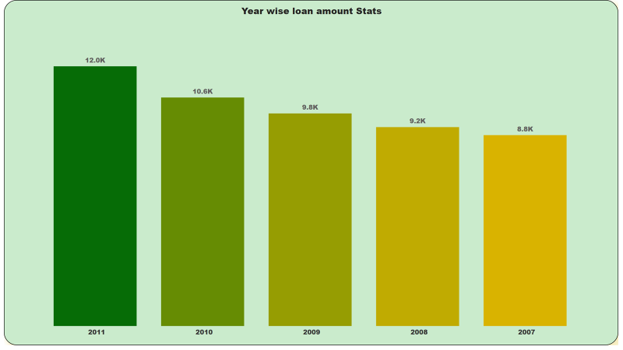
KPI-1 Year wise loan amount Stats
Year 2011 has highest loan amount stats with the average of 12 K.
Year 2007 has lowest loan amount stats among all the years i.e.8.8K.
By studying the bar chart we can clearly say that yearly the loan amount is increasing

Slide 3
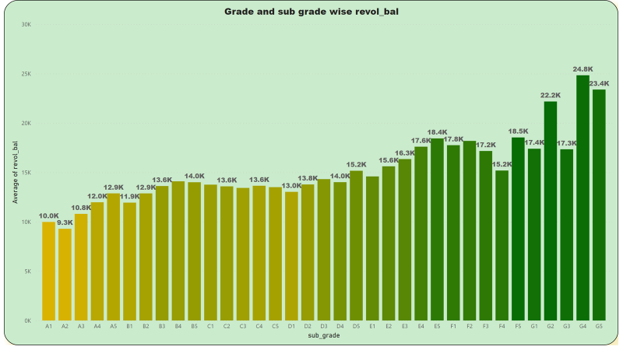
KPI-2 Grade and sub grade wise revol_bal
The Revol_bal of G4 subgrade of Grade G has highest average of revol_bal of value 24.8K.
And lowest average of Revol_bal is for A2 subgrade of grade A with a value of 9.3K

Slide 4
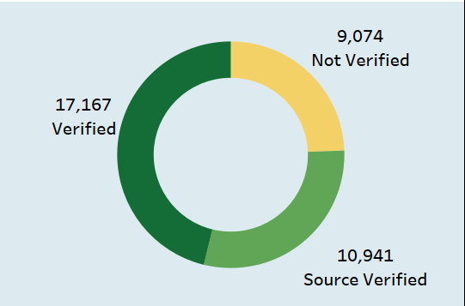
KPI -3 Total Payment for Verified Status Vs Total Payment for Non Verified Status
Total payment for verified status is highest among other verification status i.e. 17 K approx.
Total payment for non verified is lowest among other verification status i.e.9 K approx.

Slide 5
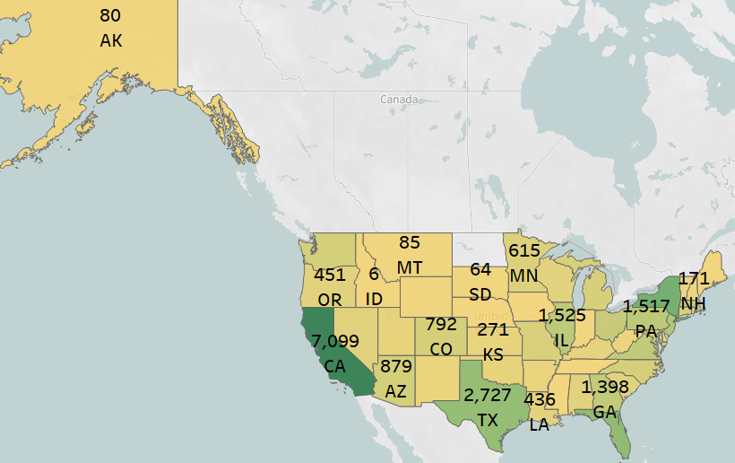
KPI-4 State wise and last_credit_pull_d wise loan status
Count of loan status according to last credit pull date is highest in California state with a count of 7 K approx.
And lowest is 3 for Maine state .

Slide 6
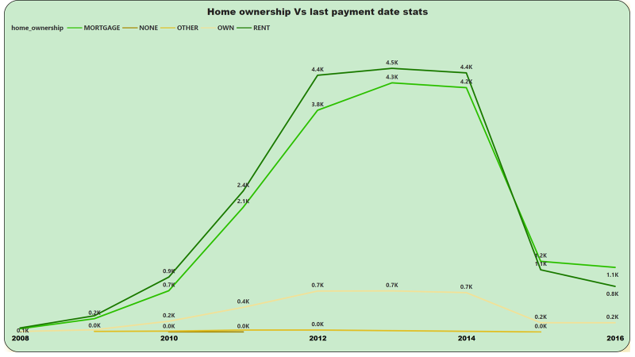
KPI-5 Home ownership Vs last payment date stats
Home ownership count of Rent is highest for 2008-2014 (max 4.5 K)and after 2014 mortgage becomes highest.
Count for home ownership values increases from 2008-2014 and then they start decreasing drastically.
And home ownership count for own and others are below average.

Slide 7
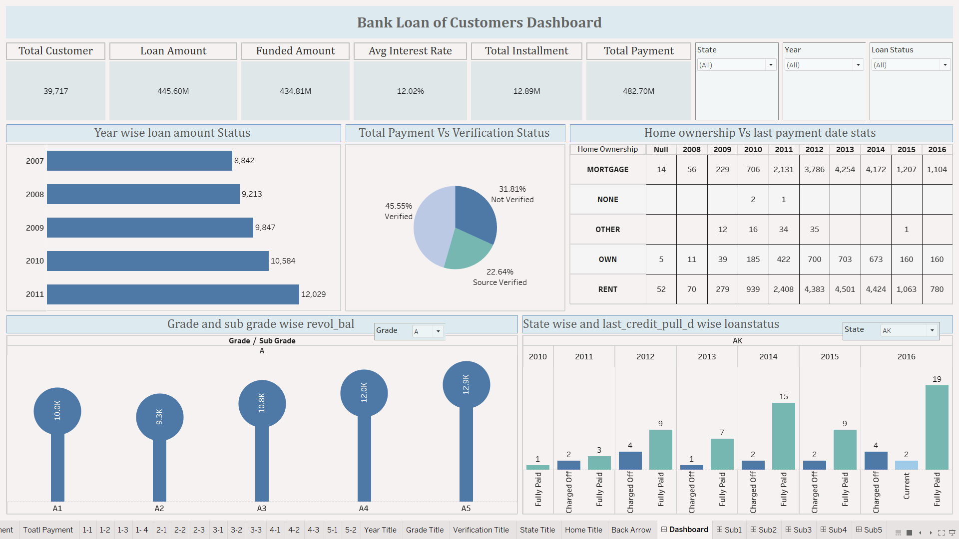
Tableau-Dashboard

Slide 8
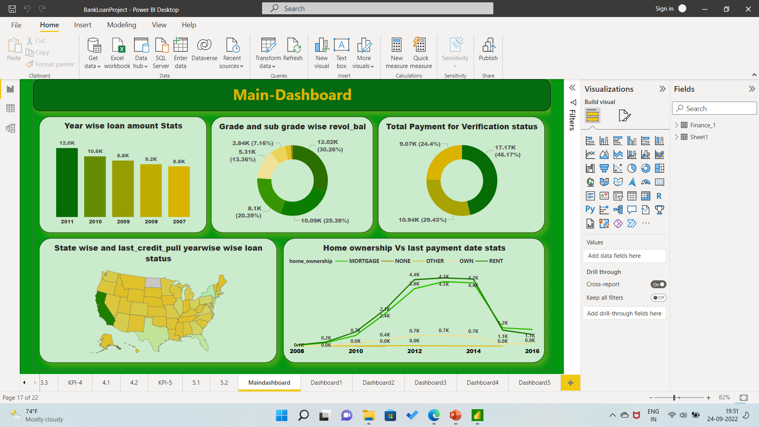
Power BI-Dashboard

Slide 9
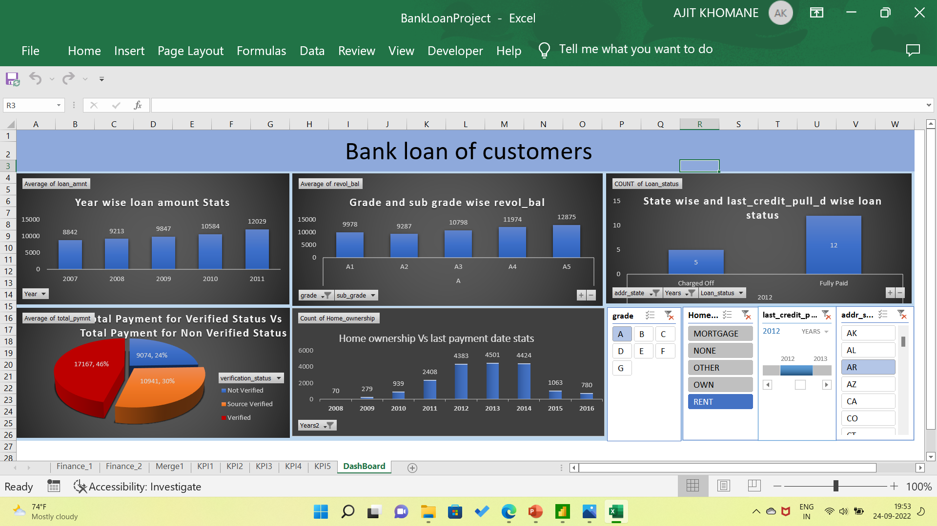
Excel - Dashboard

